Slide 1
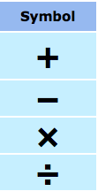





In your groups of 2-3, come up with everything you know about the following
mathematical terms:

Slide 2
24
7
30
Date
Introduction to Algebra
EQ – What are some of the keywords that I need to know when solving algebraic equations?
5

Slide 3
24
7
30
Date
Introduction to Algebra
EQ – What are some of the keywords that I need to know when solving algebraic equations?
Consider:
5

Slide 4
24
7
30
Date
Introduction to Algebra
EQ – What are some of the keywords that I need to know when solving algebraic equations?
Consider:
This is an algebraic equation. An equation is a statement
saying that “this equals that” or what is on the left side
(4x - 7) is equal to what is on the right (5)
5

Slide 5
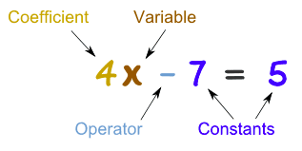
24
7
30
Date
Introduction to Algebra
EQ – What are some of the keywords that I need to know when solving algebraic equations?
Consider:
So that we can talk about equations, there are names for
the different parts (better than “that thingy there”, which
I’ve heard some of you say before!!!)
5

Slide 6
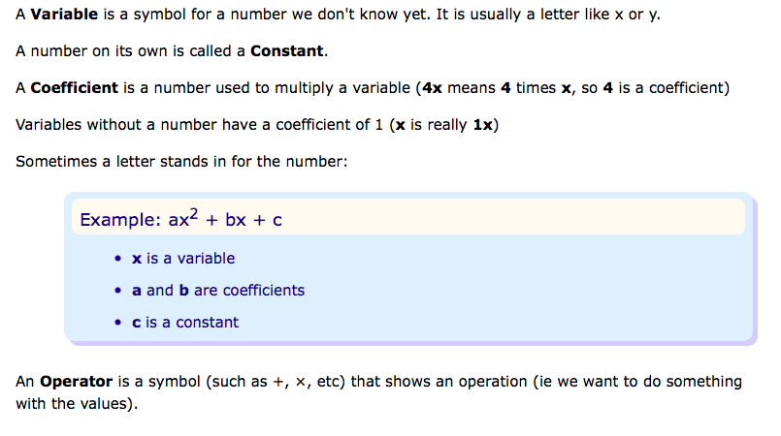
24
7
30
Date
Introduction to Algebra
EQ – What are some of the keywords that I need to know when solving algebraic equations?
5

Slide 7
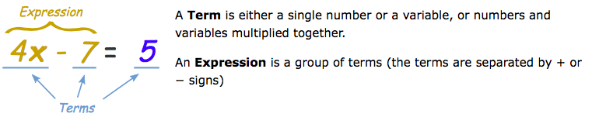
24
7
30
Date
Introduction to Algebra
EQ – What are some of the keywords that I need to know when solving algebraic equations?
Finally…
5

Slide 8
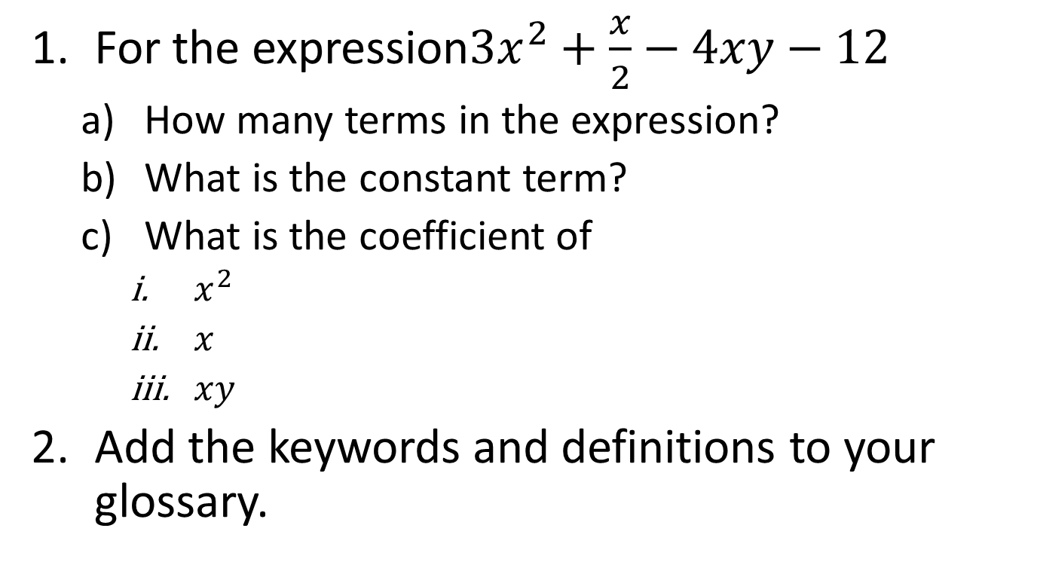
Task

Slide 9
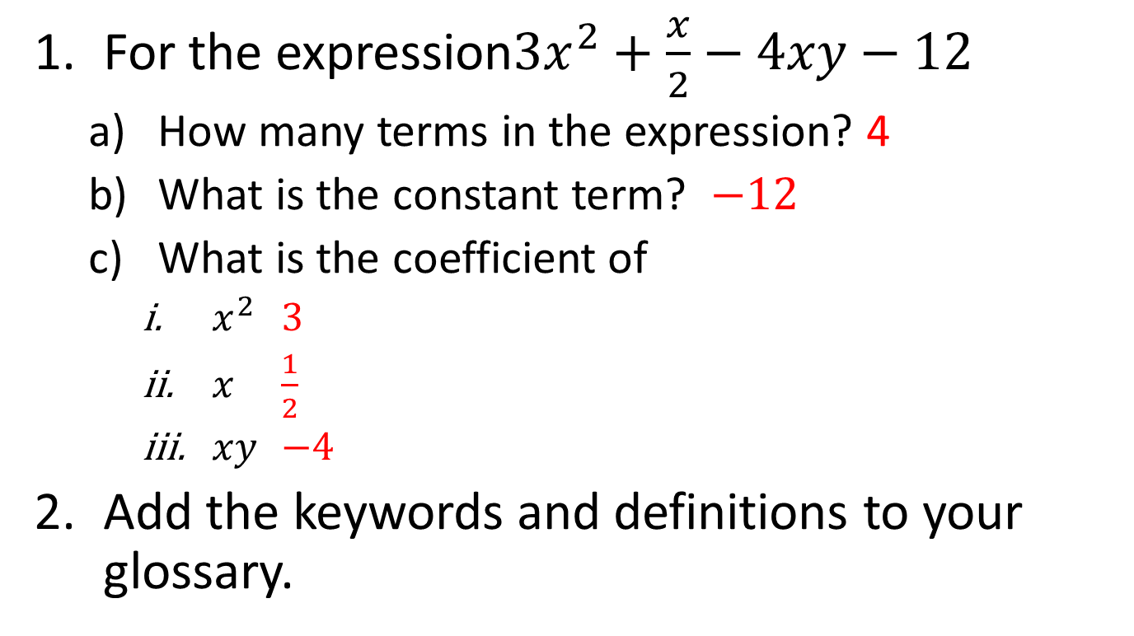
Task

Slide 10
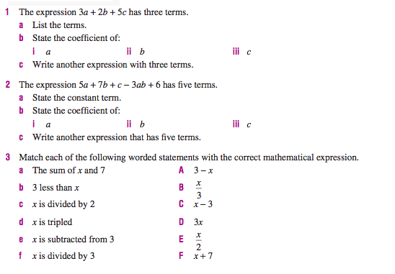

Slide 11
Notes Review
24, 7 ,30
Date
Title
Essential question
Notes complete
Notes complete with colour and diagrams
Questions completed
Contents page filled in
Formula page filled in

Slide 12
Homework
Review your notes and write a summary answering the essential question.

